Slide 1
Version Control System

Slide 2
Version Control System
Software project contains source code
A need to protect source code
VCS
Offers a repository for storing files / projects
Historical information of files / projects preserved

Slide 3
Tracking file changes
For every file changes, the following will be tracked
Who made the changes?
When the changes was made?
What was the purpose?

Slide 4
Benefits
In a team environment where many developers want to contribute changes
Supports security mechanisms
To better manage conflicts
Mechanism to provide on parallel projects

Slide 5
Types
Centralized Version Control System
Examples
Perforce, SVN, Clearcase
De-centralized Version Control System
Git, BitBucket

Slide 6
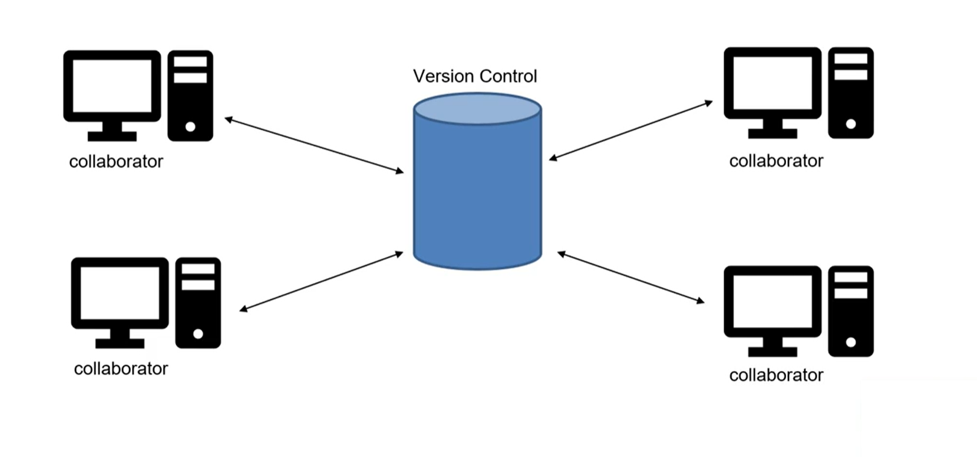
Centralized Version Control System
Contributors connect to a central server
Real intelligence lies in the central server
Works for small teams
Single point of failure
Space constraints / issues

Slide 7
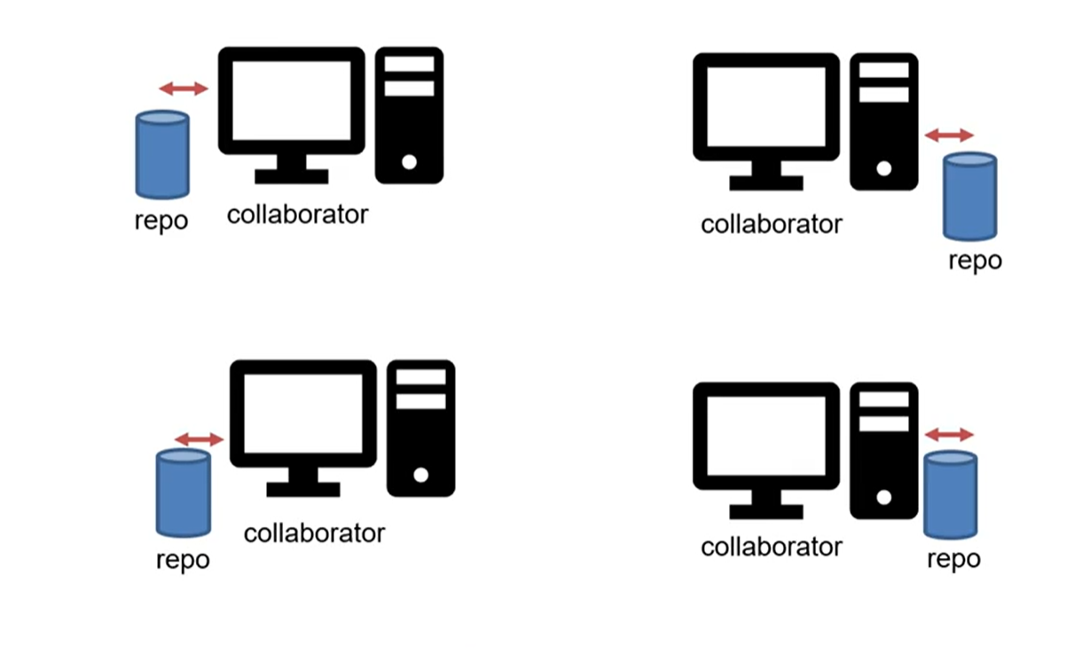
De-centralized Version Control System
Works on the concept of decentralization
A copy of VCS will belong to every developer machine
Advantages
No single point of failure
Operations are faster
Possible to have larger teams

Slide 8
Summary
Terminologies in version Control System
Benefits of Version Control System
Types of Version Control System

